Slide 1


Slide 2



introduction
Welcome to the future of inclusive currency handling! Our Banknote Identification System brings together the magic of technology and the power of accessibility. Imagine holding a banknote, scanning it with a simple device or app, and instantly knowing its value — all without needing to see it. This system ensures that managing money isn’t just easier, it’s empowering, safe, and designed just for you.

Slide 3

Project profile
The primary objective of this project is to develop a mobile application that utilizes computer vision and machine learning technologies to assist visually impaired individuals in identifying and differentiating between various denominations of Indian banknotes.
This application aims to enhance the
independence and confidence of users by
providing real-time identification of currency,
thereby addressing the challenges they face in
handling cash.

Slide 4
Development tools and technology used
Front End
back End
Machine learning framework
database
Android Studio (for mobile application development)
Python (for server-side processing)
Tensore Flow(for training and deploying machine learning models
MySQL (for storing user data and application logs)

Slide 5

Screen page layouts

Slide 6
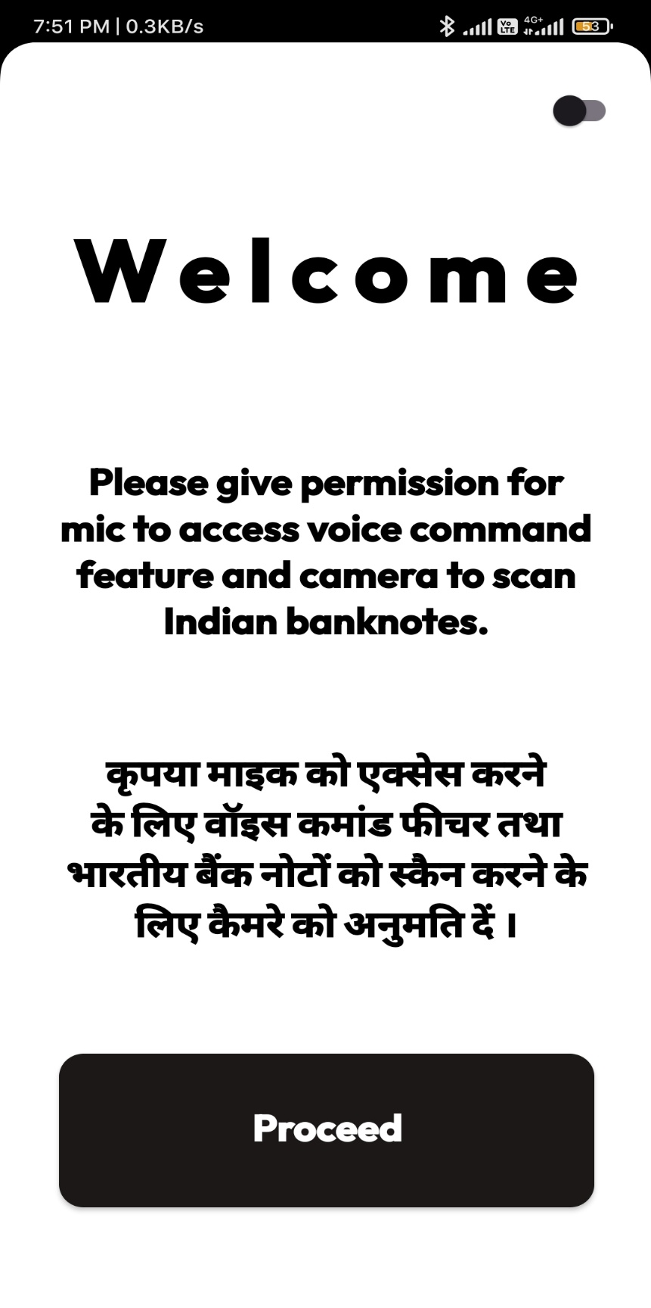
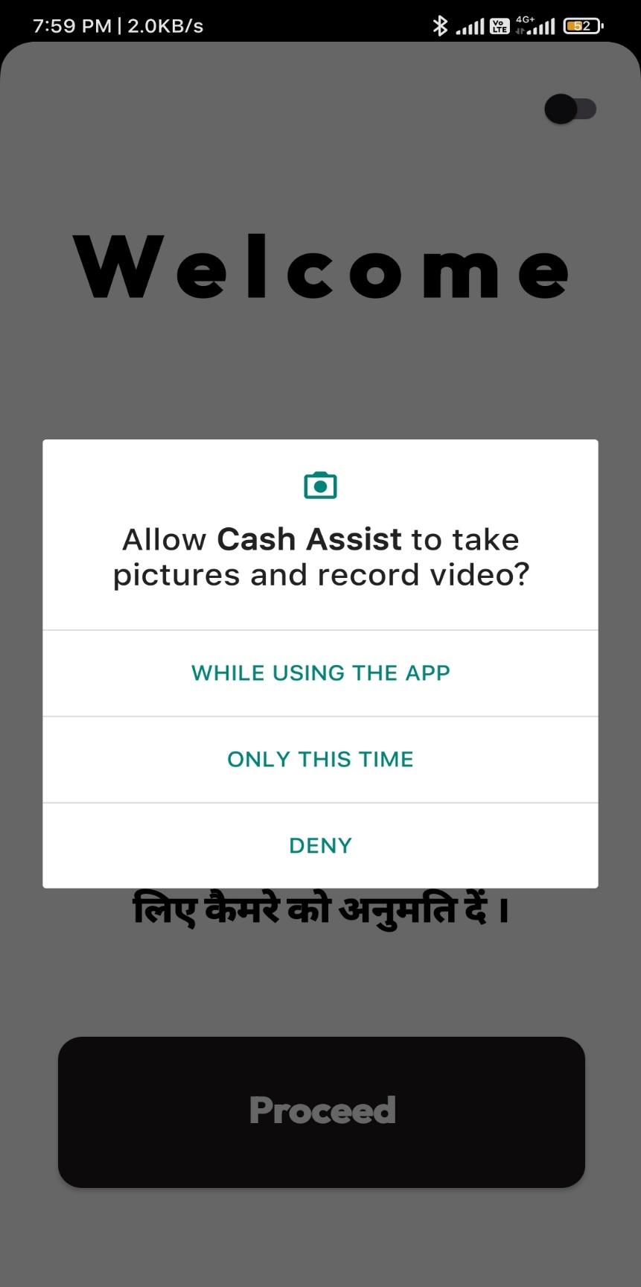
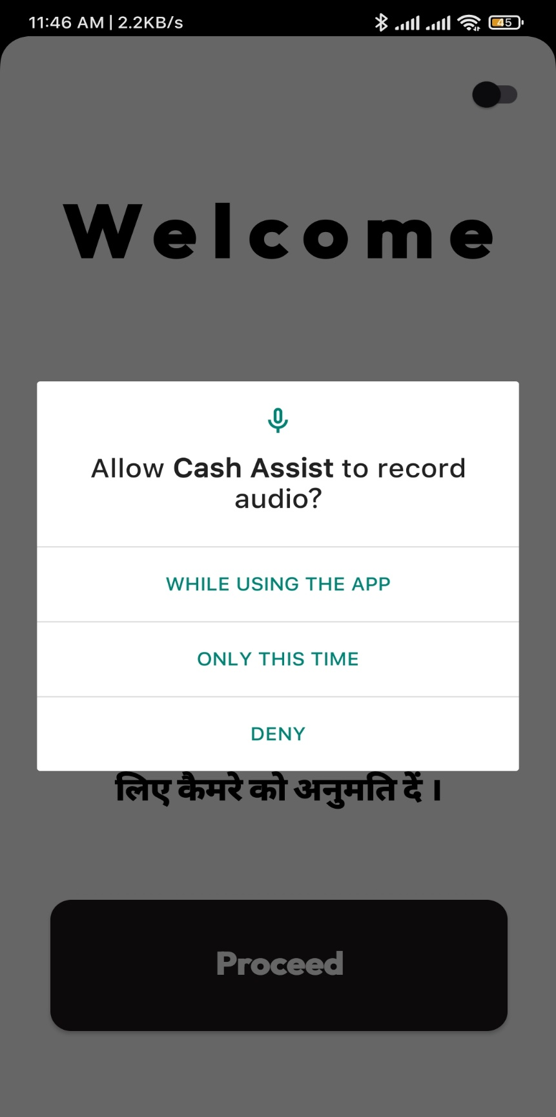
WELCOME PAGE:
CAMERA PERMISSION: MIC PERMISSION:

Slide 7
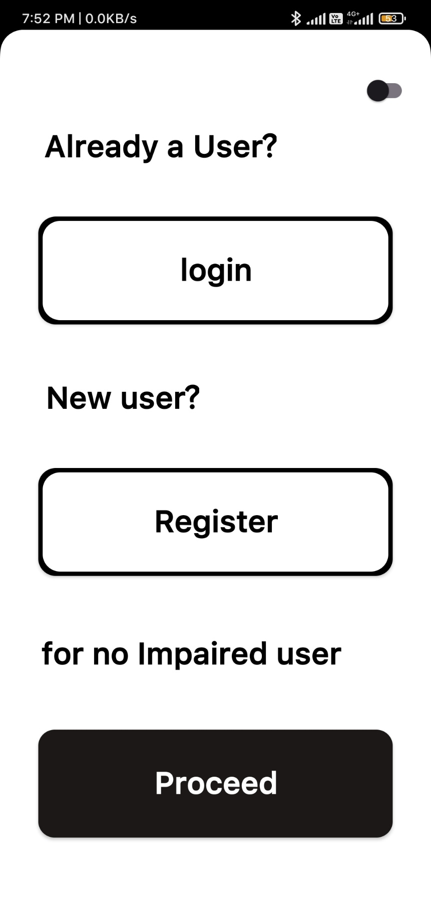
USER TYPE:

Slide 8
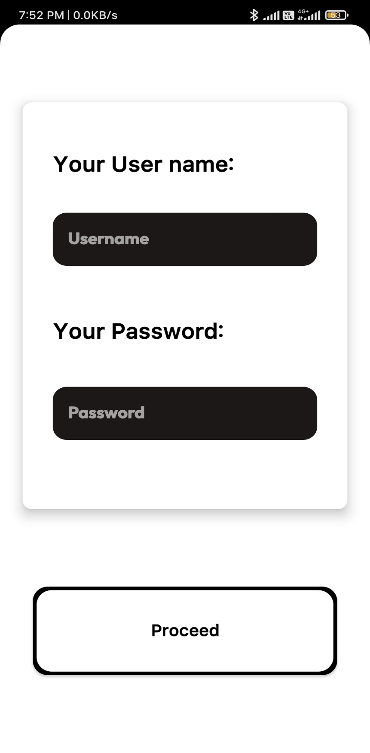
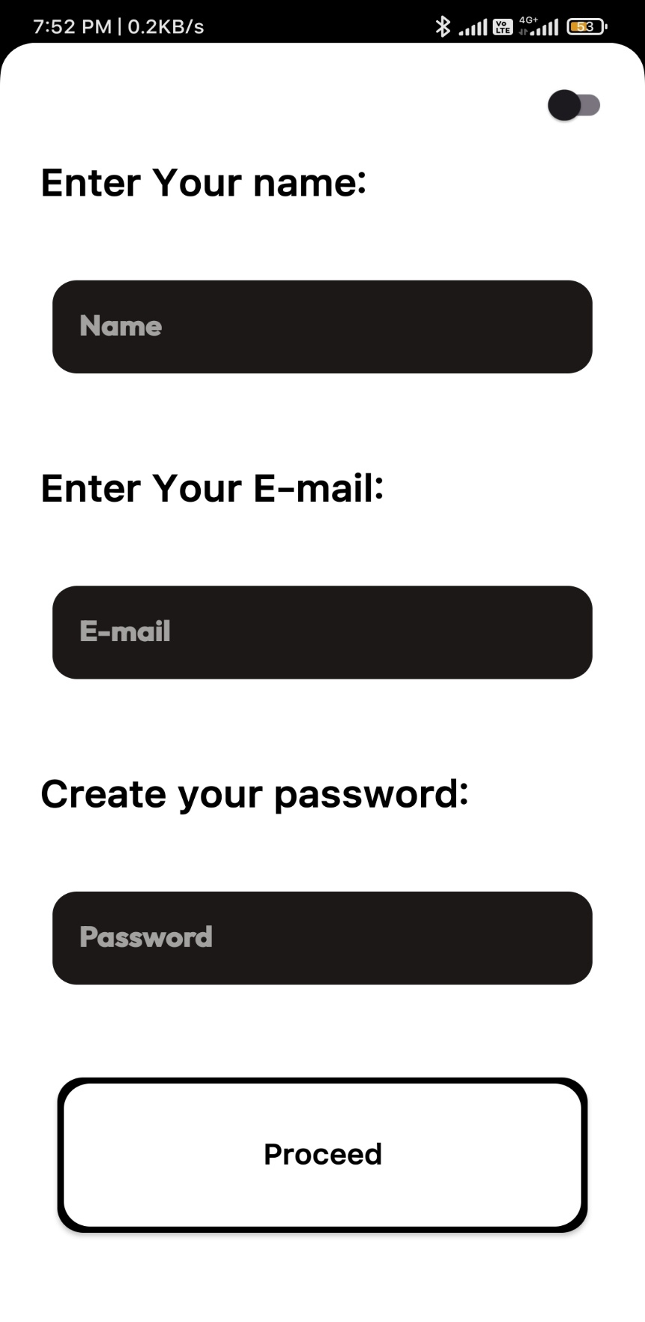
LOGIN PAGE:
REGISTER PAGE:

Slide 9
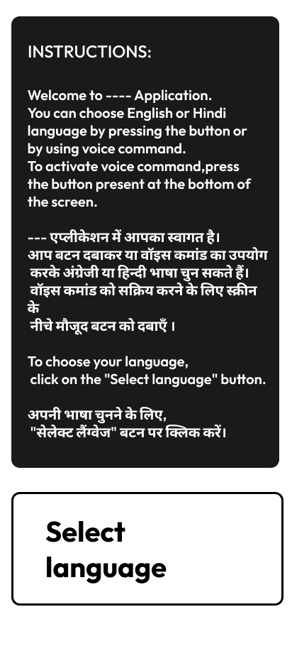
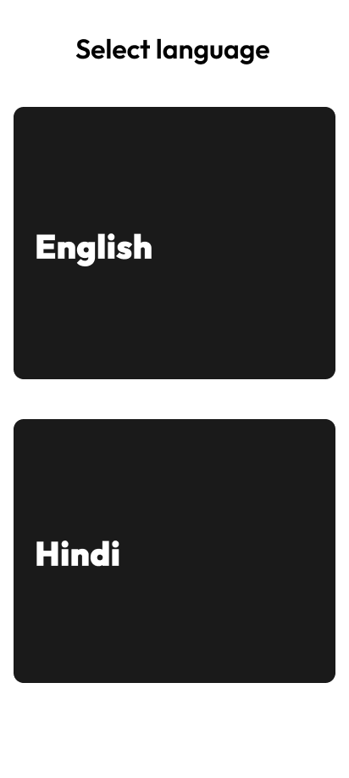
INSTRUCTION PAGE:
LANGUAGE SELECTION
PAGE:

Slide 10
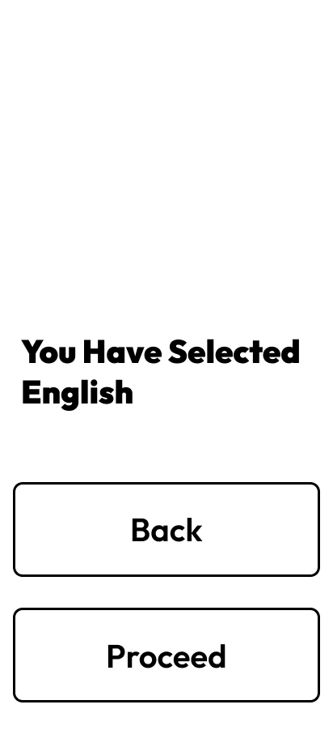
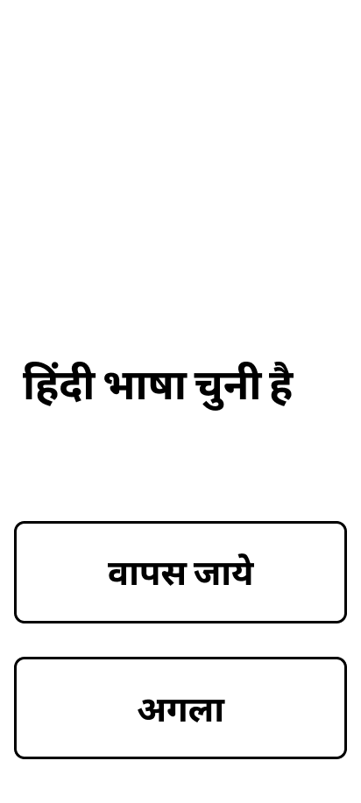
LANGUAGE CONFORMATION PAGE:
LANGUAGE CONFORMATION
PAGE:

Slide 11
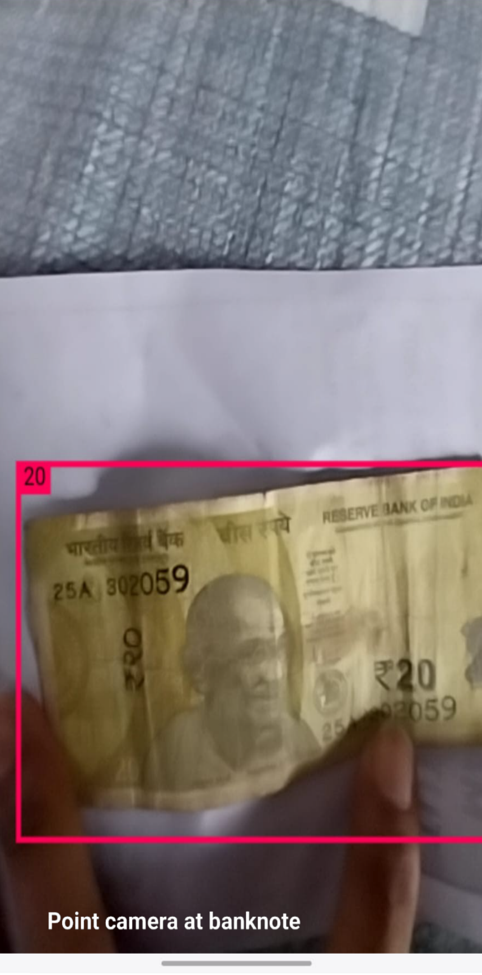
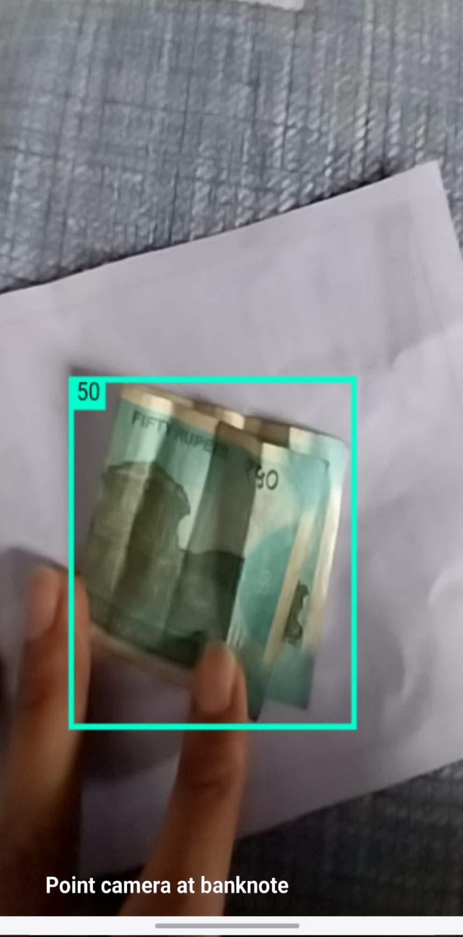
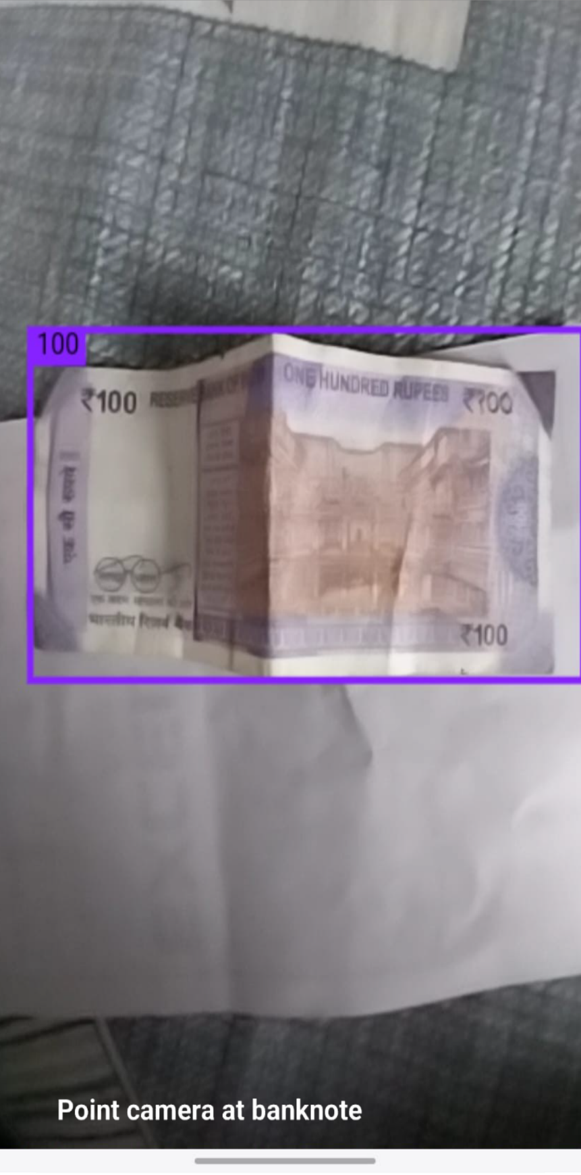
SOME OUTPUTS OF TRAINED MODEL
20 RUPEES:
50 RUPEES: 100 RUPEES:

Slide 12
Admin panel

Slide 13
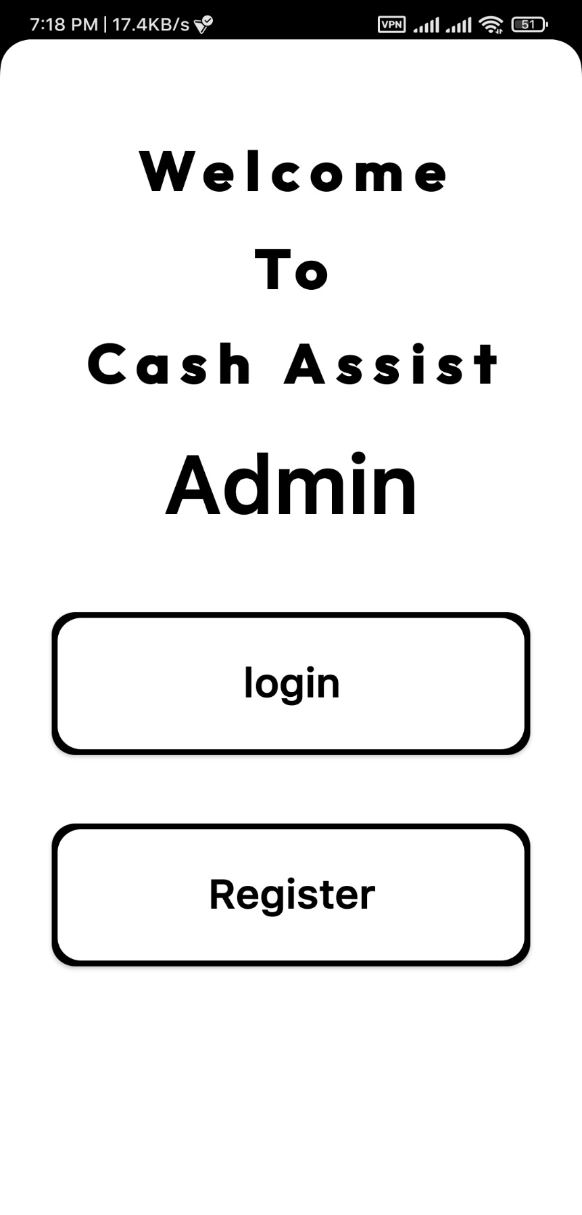
WELCOME PAGE:

Slide 14
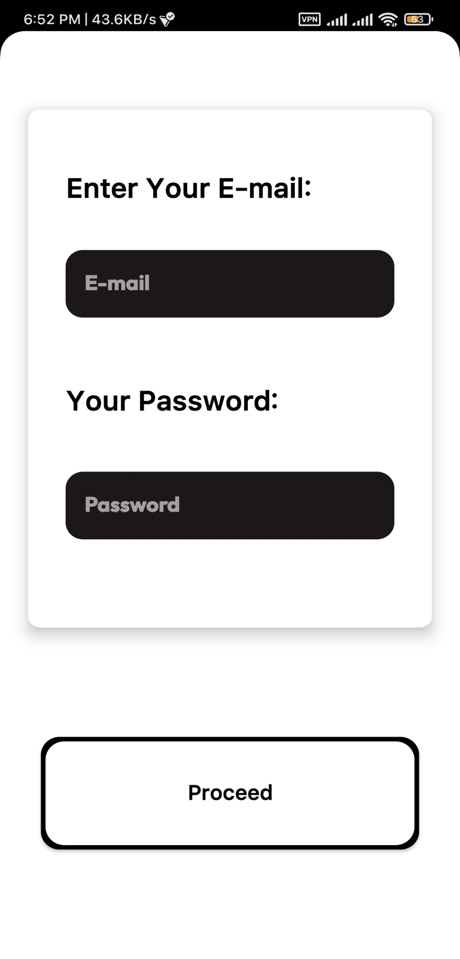
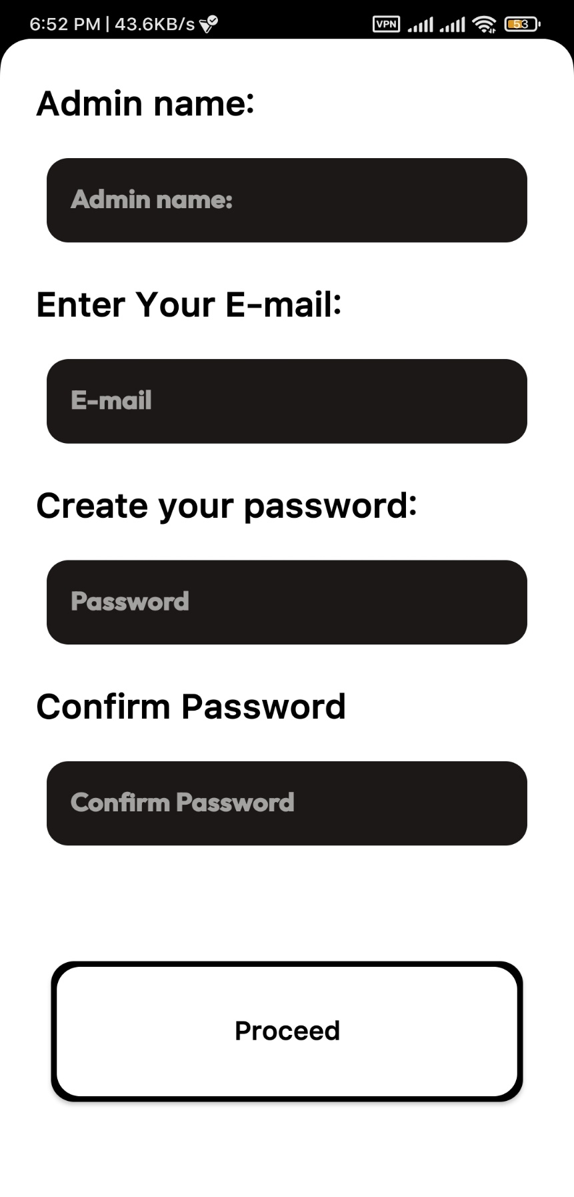
LOGIN PAGE:
REGISTER PAGE:

Slide 15
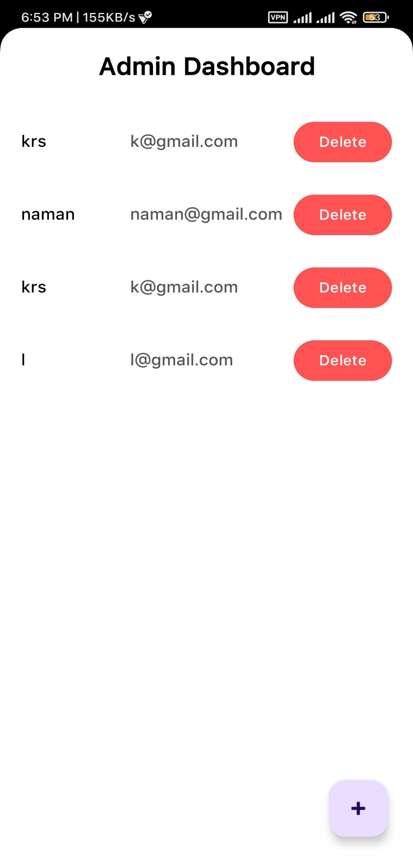
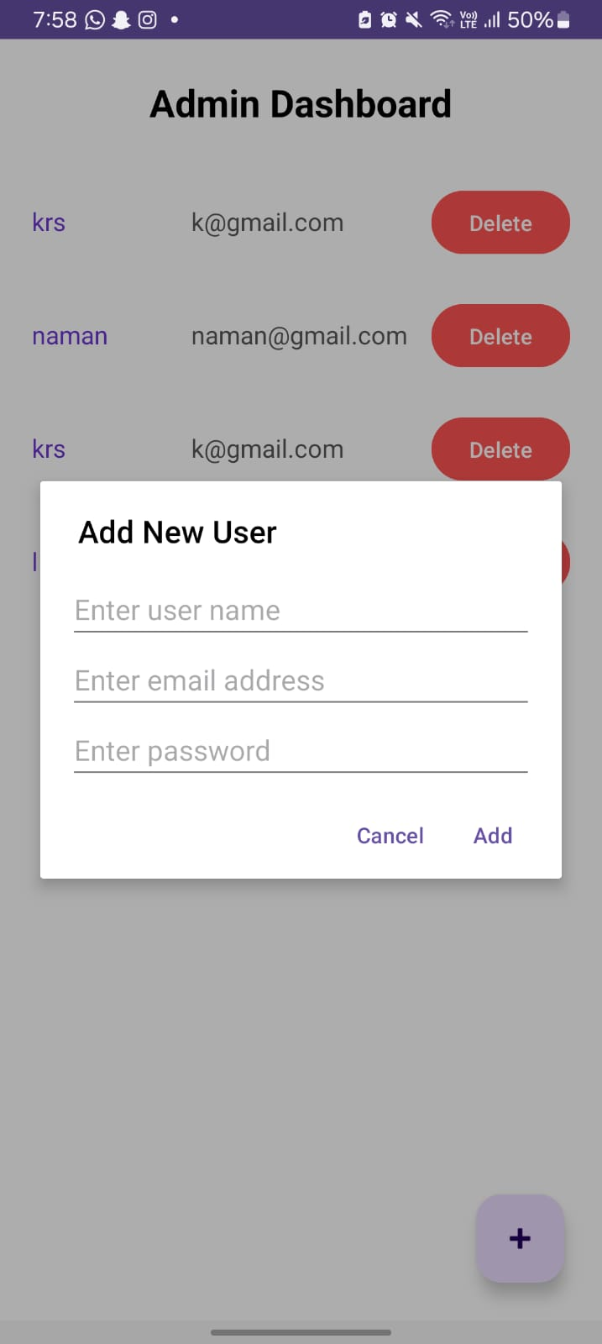
ADMIN DASHBOARD PAGE:
ADD NEW USER PAGE:

Slide 16

CONCLUSION
The Bank Note Identification app (CASH ASSIST) successfully empowers visually impaired individuals by providing an accessible and reliable solution for identifying currency. With its intuitive interface, seamless navigation, and essential features like real-time audio feedback, accurate denomination detection, and user-friendly design, the app ensures independence and confidence in financial transactions.

Slide 17
CONCLUSION
The incorporation of accessibility-focused features enhances the user experience, making interactions more inclusive and efficient. As final refinements in voice command integration and multi-currency support are completed, the Bank Note Identification app stands as a well-rounded, functional, and impactful assistive tool. Future enhancements could include AI-driven object recognition for additional everyday items, multilingual voice output, and expanded compatibility with various banknote designs to further improve usability and reach.

Slide 18
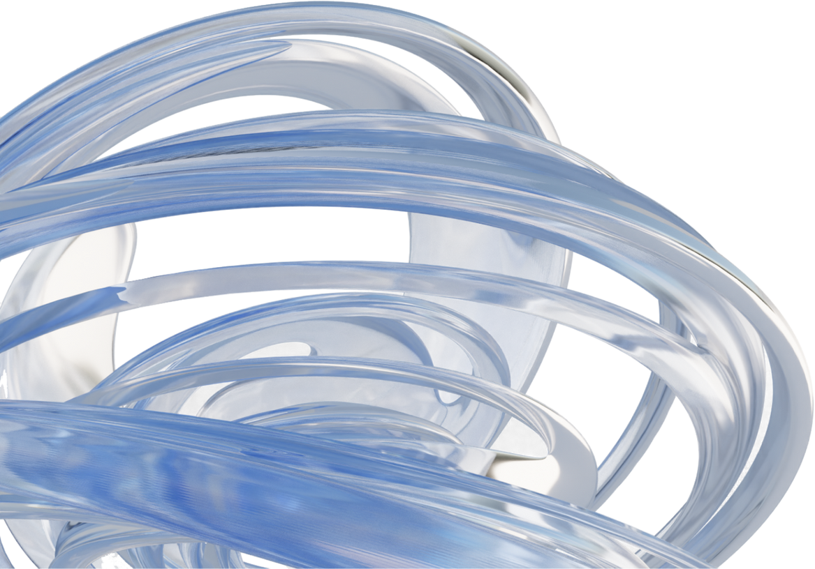
bibliography
https://chatgpt.com/gpts
Android Mobile App Developer Tools – Android Developers
https://github.com/
https://www.kaggle.com/
https://www.youtube.com/
https://diagrammingai.com/
https://demo.roboflow.com/inr-note-detection-0hws8/1?publishable_key=rf_loKvYIMN1PPOXoBgOvrgKxan2Cs2

Slide 19

THANK YOU

